Slide 1

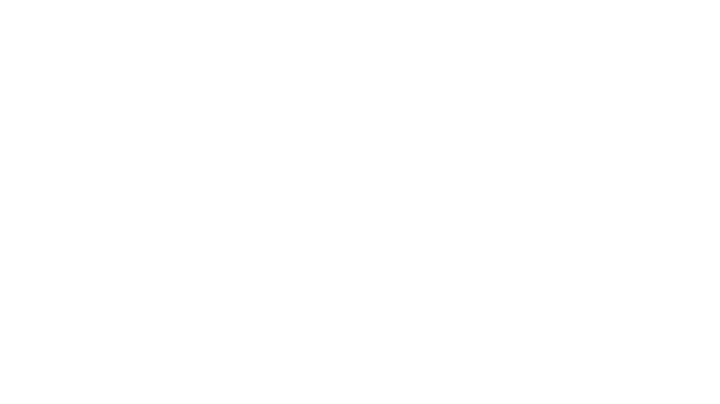

Multi-camera object detection using yolov3 on Nvidia jetson tx2
Team Members
Girish Tabaraddi 1119236
Drashti Shah 1119295
Madeshwar Ganapathy 1120093
Trusha Tagade 1120564
Yogita Labde 1119264
Project – SS23
Under the Guidance of Prof. Dr. Schumann

Slide 2
AGENDA
What is Yolov3?
Yolov3 Network Architecture
Tools Used
Nvidia Jetpack SDK
Jetson TX2 stats
CPU and GPU Comparison
Multicamera Implementation
Object Detection and Implementation
Facemask Detection Implementation
Performance Comparison
Future Scope: Sensor Fusion

Slide 3
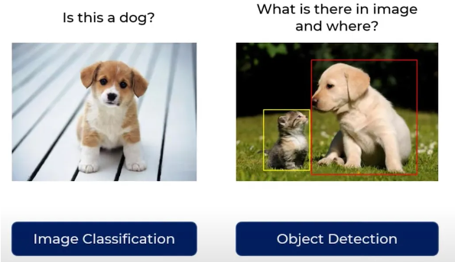
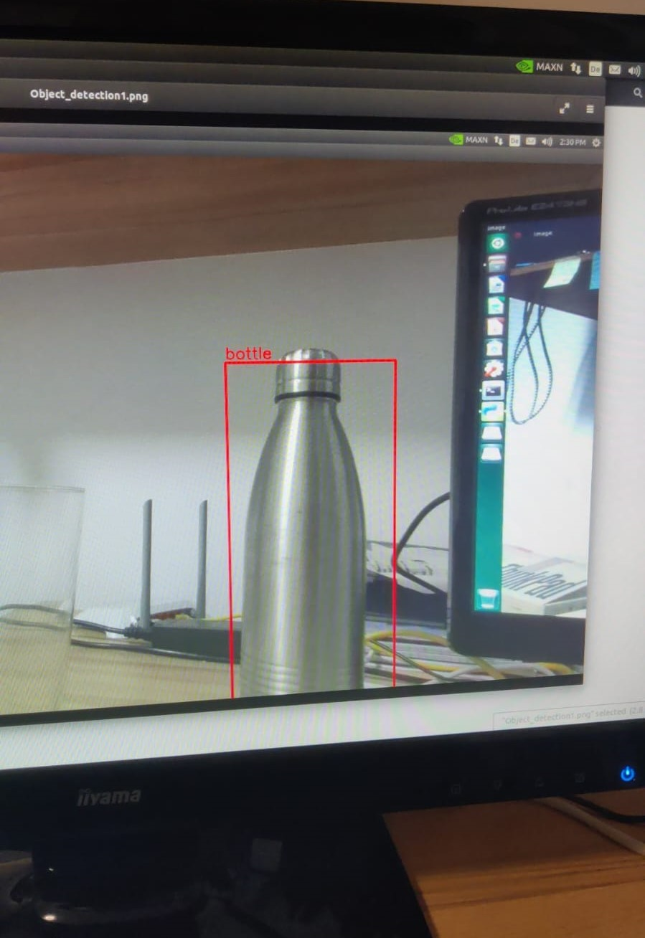
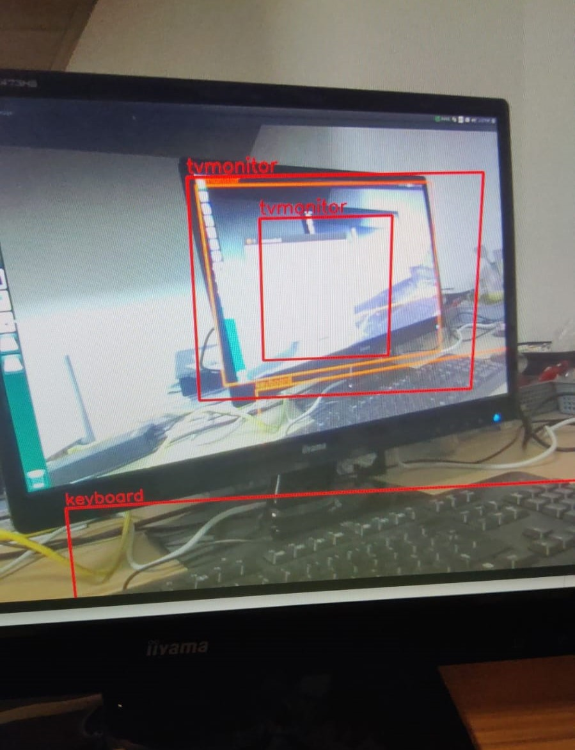
What is YOLOv3?
YOLO (You Only Look Once) is a single shot detector that uses a fully Conventional Neural Network (CNN) to process an image.
Generally, single shot object detection is better suited for real-time applications, while two shot object detection is better for applications where accuracy is more important.
One key technique used in the YOLO models is Non-Maximum Suppression (NMS).

Slide 4
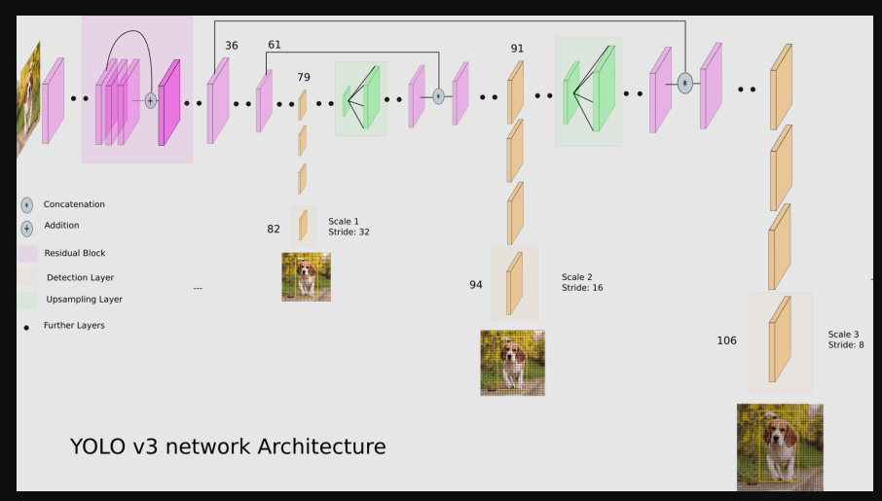
Yolo v3 Network Architecture
YOLO v3 uses a variant of Darknet, which has 53-layer network trained on Imagenet.
Darknet-53 is used as a feature extractor.
YOLO makes use of only convolutional layers, making it a fully convolutional network (FCN)

Slide 5
Tools Used
The pre-requisite software for the project is Nvidia SDK 1.9.2 and other libraries are mentioned below with their versions.
https://www.stereolabs.com/blog/nvidia-jetson-l4t-and-jetpack-support/ This blog mentions all the needed tool version for flashing TX2
Nvidia Jetpack 4.6.3
CUDA 10.2.300
Python 3.6.9
ZED SDK
OpenCV 4.5.5 with CUDA enabled
Ubuntu 18.04 Linux System

Slide 6
Nvidia JETPACK SDK
NVIDIA Jetpack SDK is the most comprehensive solution for building AI applications.
Jetpack includes Jetson Linux with bootloader, Linux kernel, Ubuntu desktop environment, CUDA ,OpenCV, TensorRT etc.
For installing Jetpack SDK, we need to first install Nvidia SDK Manager on a host computer running Ubuntu and then run Jetpack installer executable.
This host computer needs to be connected to the TX2 either through a USB cable or over a common Local Area Network.
The user can select the software components that they want to install on the target TX2 in the installation wizard.

Slide 7
Flashing on Jetson tx2
Install Nvidia SDK manager which in turn installs all the necessary libraries required for flashing software on TX2.
Once the software is flashed, now boot up the system with Linux Ubuntu OS and ZED SDK can be installed.
ZED SDK has few checks to be executed and then the cameras are turned on, if the installation is correct.
Next step is to install OpenCV and tensor flow libraries, all the steps are explained in detail in the report.

Slide 8
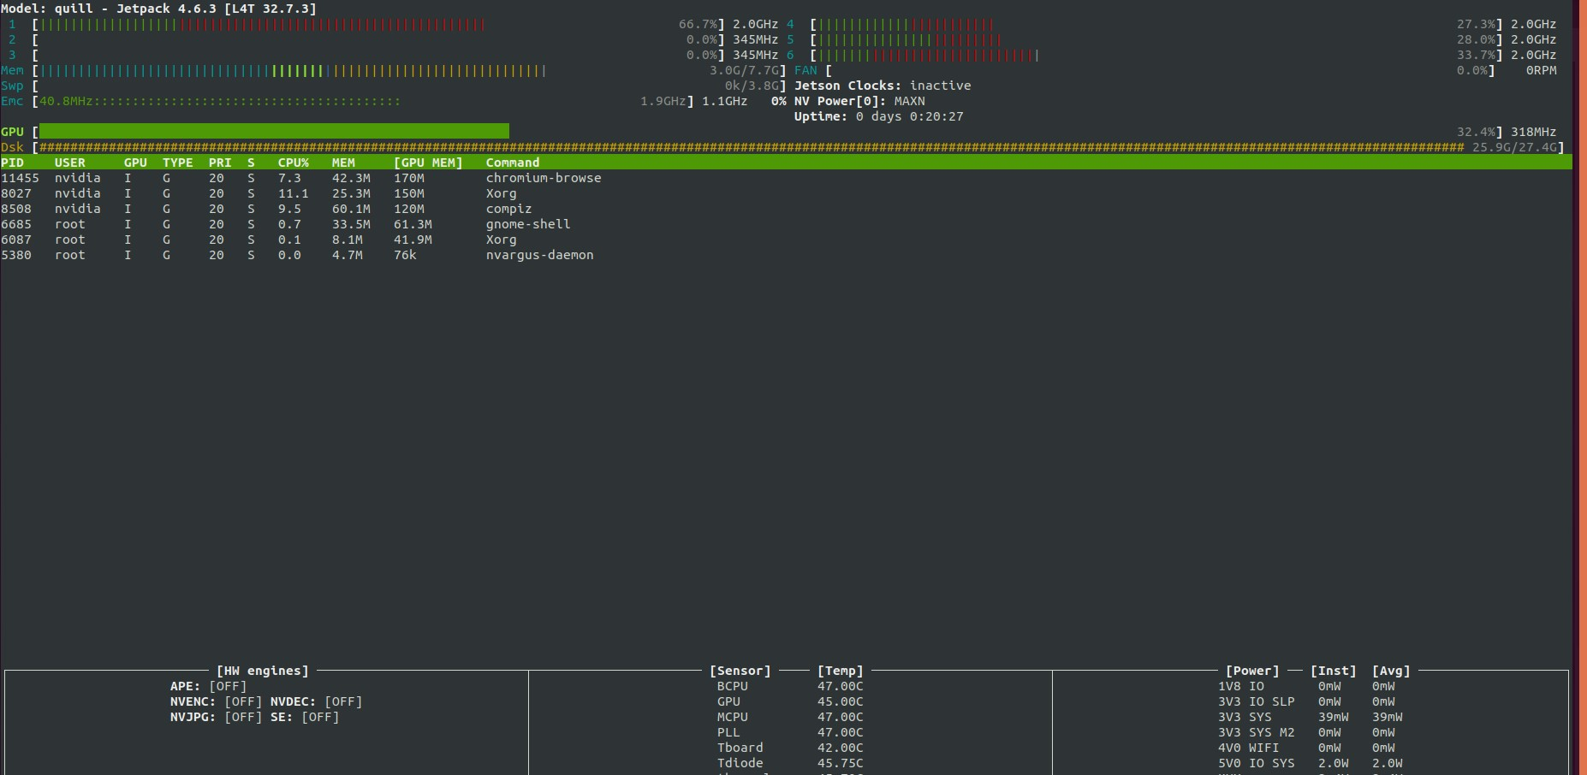
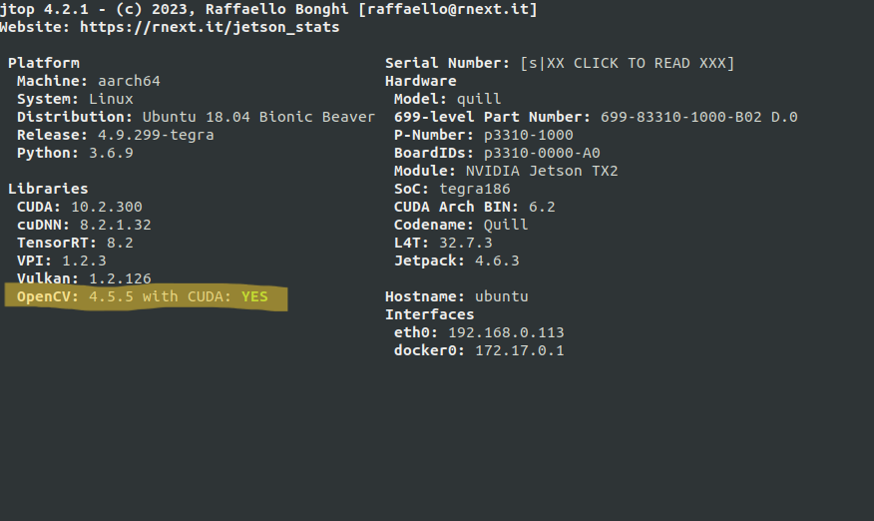
JETSON TX2 STATS:

Slide 9
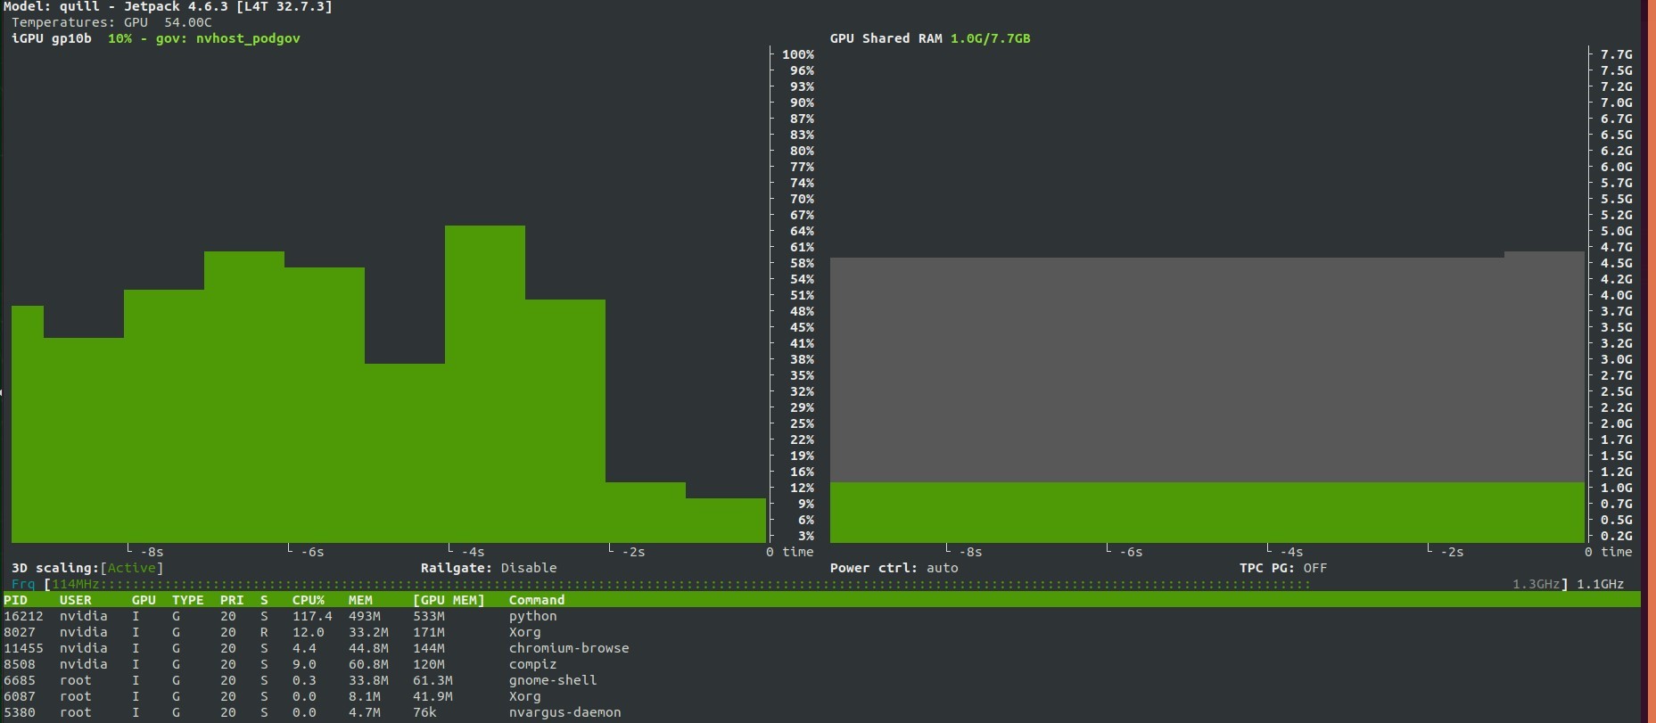
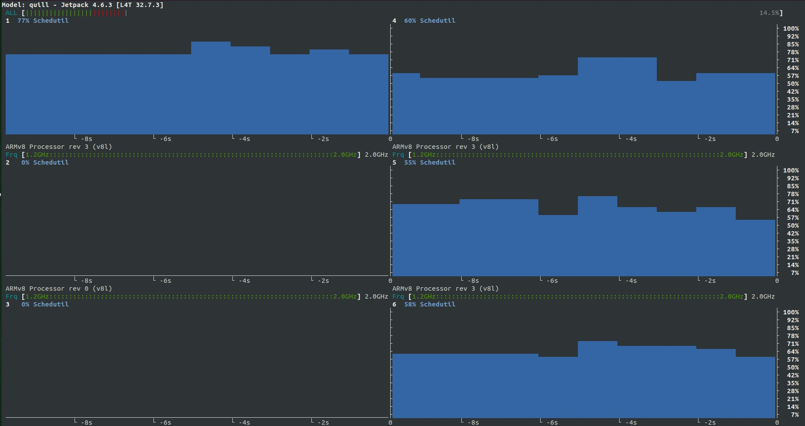
CPU and GPU Comparison

Slide 10
ZED Camera Features
USB Bandwidth: The ZED in 1080p30 mode generates around 250MB/s of image data. USB 3.0 maximum bandwidth is around 400MB/s, so the number of cameras, resolutions and framerates you can use on a single machine will be limited by the USB 3.0 controller on the motherboard. When bandwidth limit is exceeded, corrupted frames (green or purple frames, tearing) can appear.
Using single USB 3.0 controller, here are configurations that we tested:
2 ZEDs in HD1080 @ 15fps and HD720 @ 30fps
3 ZEDs in HD720 @ 15fps
4 ZEDs in VGA @ 30fps
To use multiple ZED at full speed on a single computer, we recommend adding USB3.0 PCIe expansion cards.
You can also use multiple GPUs to load-balance computations (use param.device to select a GPU for a ZED) and improve performance.

Slide 11
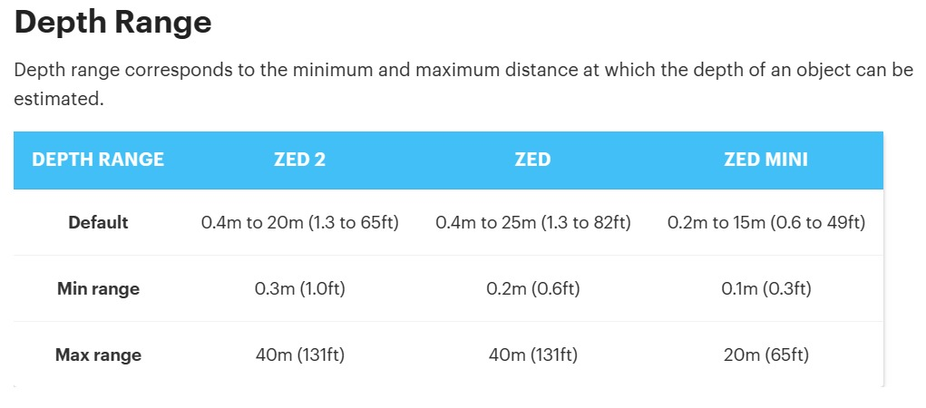
ZED CAMERA RANGE

Slide 12
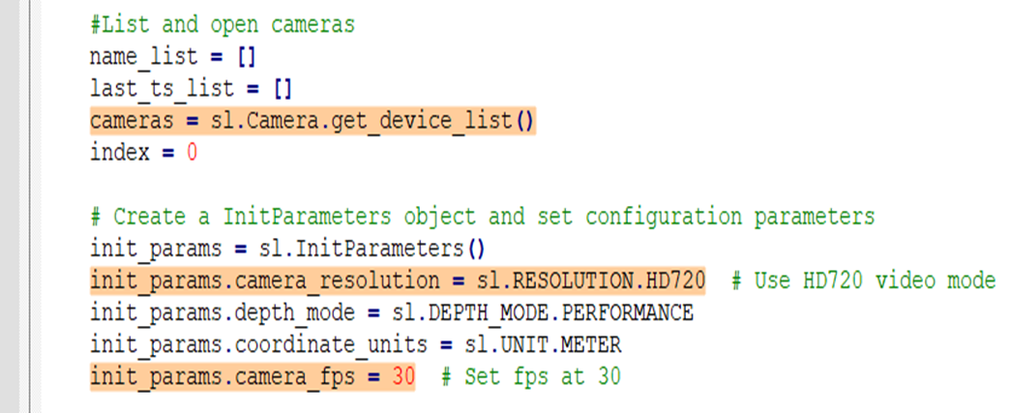
MULTI_CAMERA IMPLEMENTATION : GET DEVICE LIST
The camera object is created which retrieves the list of connected ZED Cameras using sl.camera.get_device_list () function.
The initialization parameters, encapsulated in the init_params object, are set to define the camera’s operating parameters. These include camera resolution, depth mode, coordinate units, and camera frame rate.

Slide 13
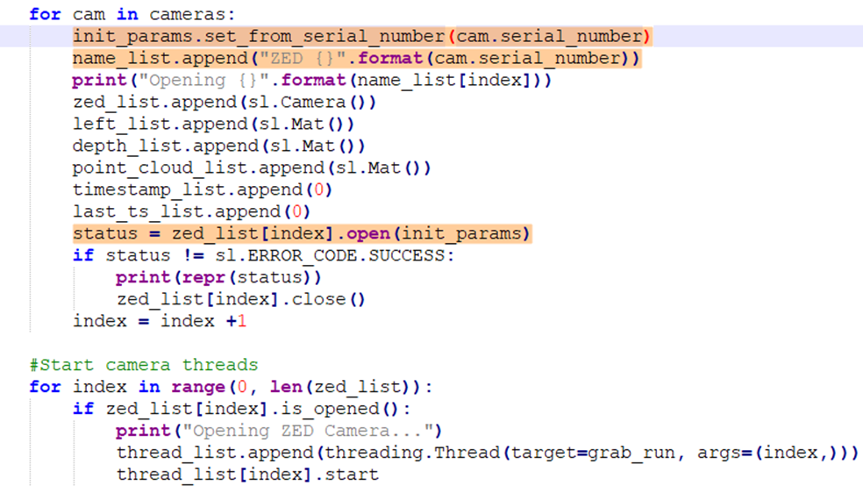
MULTI_CAMERA IMPLEMENTATION : OPENING CAMERA
For each camera, the initialization parameter is set based on the serial number obtained from the camera list.
A variety of data structures are prepared to manage the camera data, including zed_list for camera objects, left_list for left images and depth_list for depth images. The name_list stores the serial number of each ZED camera.
The ZED camera is then opened using the specified initialization parameters and serial number.

Slide 14
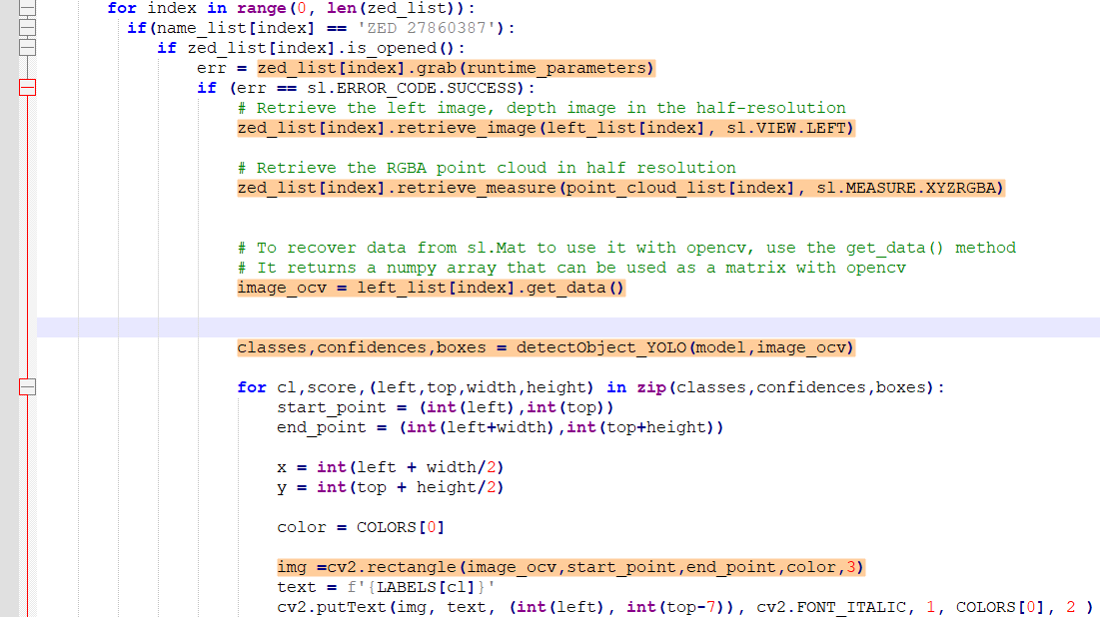
OBJECT DETECTION implementation USING MULTI-CAMERA
Iterate through the list of opened ZED Cameras, compare the serial number and perform object detection using pre-configured YOLO Model.
Grab the runtime parameters. Retrieve the left image and point cloud in RGBA format.
detectObject_YOLO function sets up model parameters, converts the image format and perform object detection. It returns class labels, confidence scores and bounding box co-ordinates.

Slide 15
DISTANCE ESTIMATION
Distance Estimation is based on the depth sensing feature of ZED Camera.
2 modes – Depth Map and Point Cloud
In Depth Map method, the ZED Camera captures synchronized images from its left and right cameras, compares the corresponding pixels and computes the disparity for each pixel.
The disparity information is then used to calculate the depth of each pixel. The calculated depths are assembled into a depth map. Each pixel in depth map represents distance from camera.
In 3D point cloud method, using the depth information the camera constructs a 3D point cloud where each point has (x, y, z) co-ordinates.
These co-ordinates define the spatial position of objects in scene relative to camera and contain color information.

Slide 16
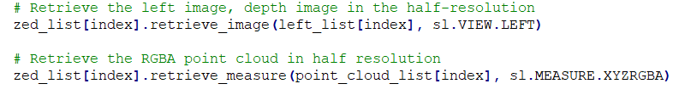
Distance estimation implementation using multi-camera
A 3D point cloud with (X,Y,Z) co-ordinates and RGBA color can be retrieved using 'retrieve_measure()'.
To access specific pixel, we will use getValue() and use Euclidian distance formula to calculate distance of an object relative to the left eye of the camera.

Slide 17
Implementation video
Project demo video is added in GitHub

Slide 18
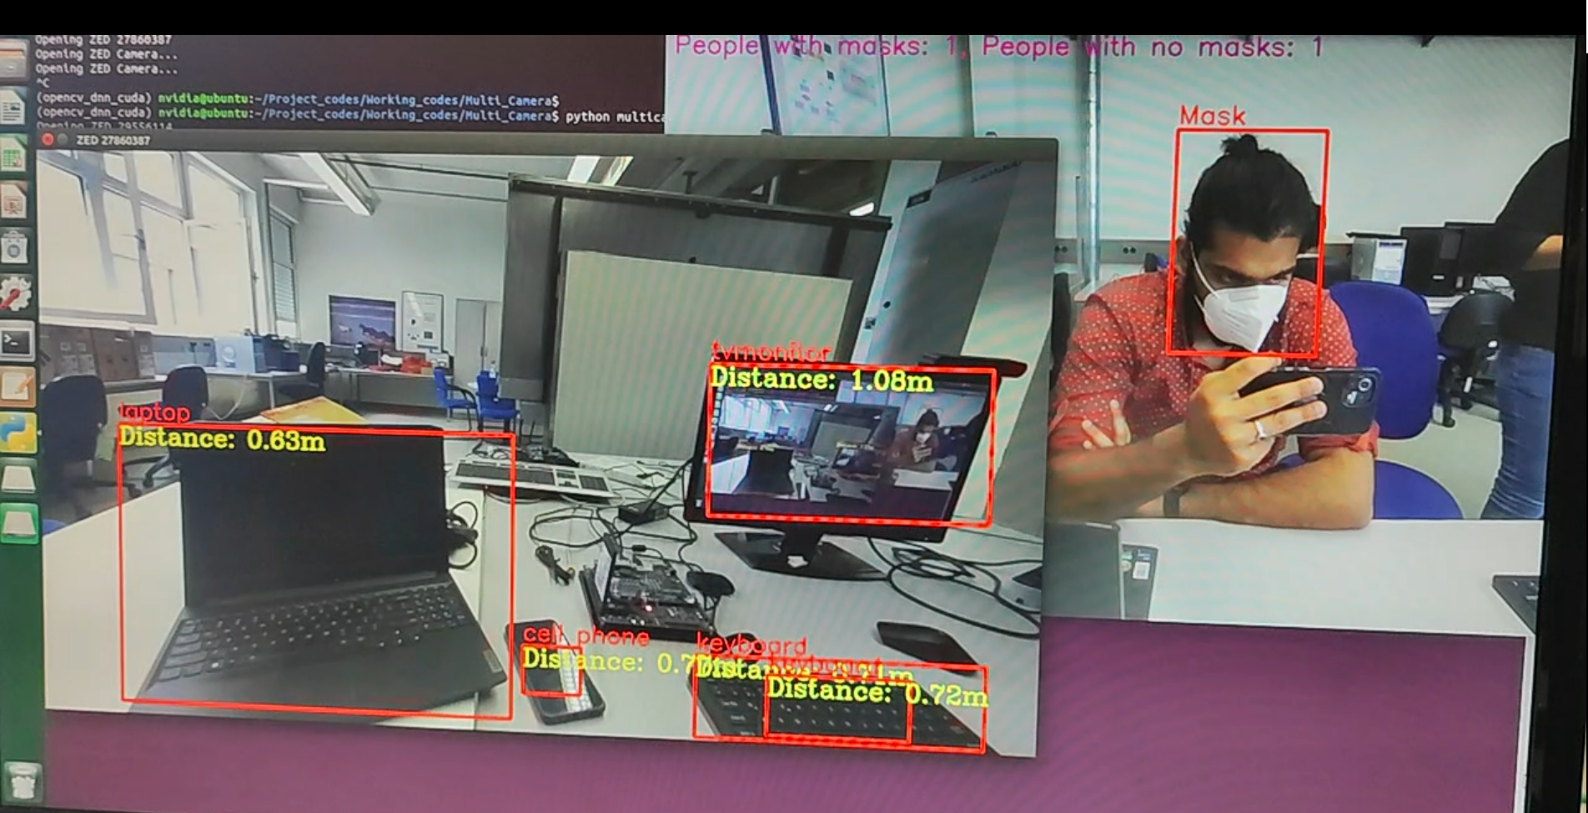
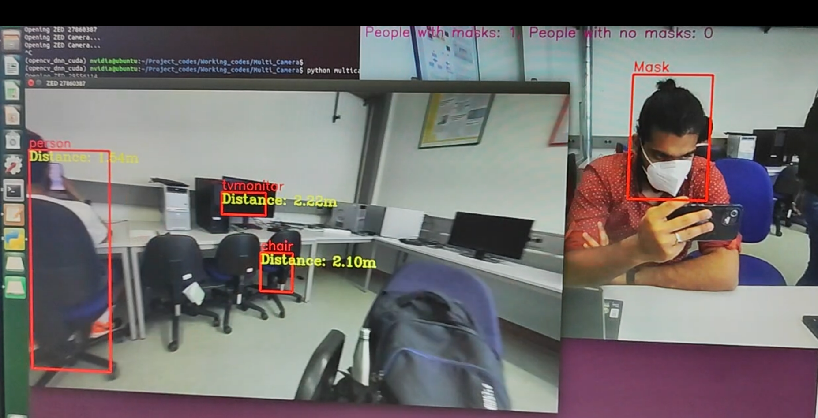

Slide 19
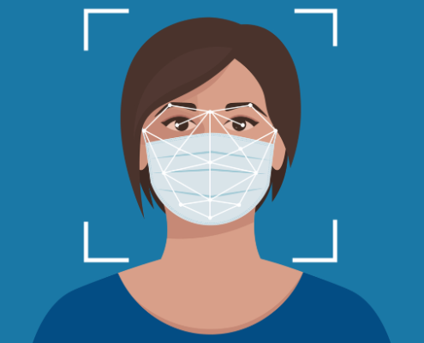
Face-mask Detection implementation
•In the era of pandemics, face mask detection plays a pivotal role in public health.
•Face mask detection technology has emerged as a powerful tool in enforcing safety measures in public spaces, workplaces, and healthcare settings.
•The purpose of this presentation is to explain how we implemented face mask detection using YOLO (You Only Look Once) and OpenCV.

Slide 20
The YOLO Model
•Our object detection/face mask detetion backbone is the YOLO model.
•YOLO stands for You Only Look Once and is a real-time object detection system.
•In this project, we utilized the 'yolov3-tiny' version for faster processing.
•The YOLO model requires two essential files for configuration: the model configuration file and the model weights file.
•The configuration file defines the architecture of the neural network.
•The weights file contains the learned parameters of the model.

Slide 21
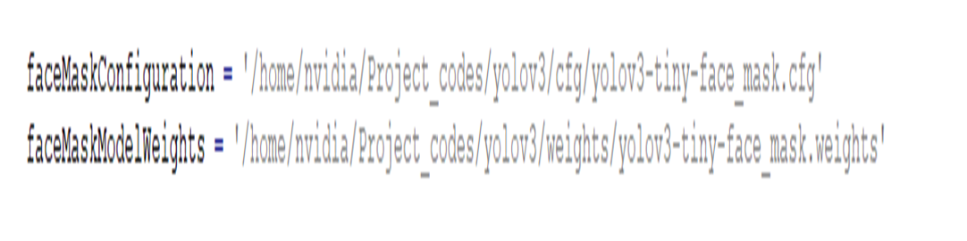
LoaD CFG AND wEIGHTS

Slide 22
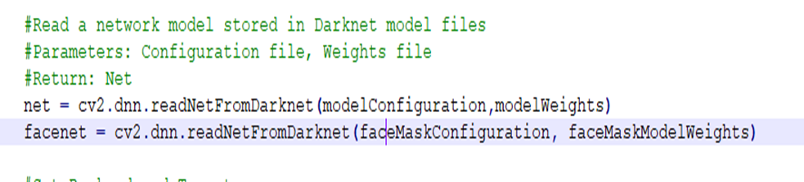
Preparing Face Mask Detection Model
Variables that are created using the cfg and weights
Holds the file path for our specialized face mask detection
These variables (net and facenet) represent the structures and architecture of the neural networks.

Slide 23
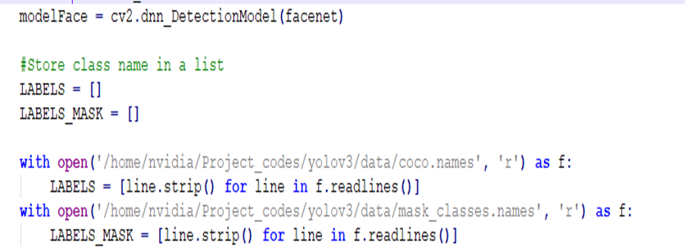
Detection models and loading class labels
Models that are created using neural network architecutre
These labels are specifically tailored for recognizing two classes: "Mask" and "No Mask"

Slide 24
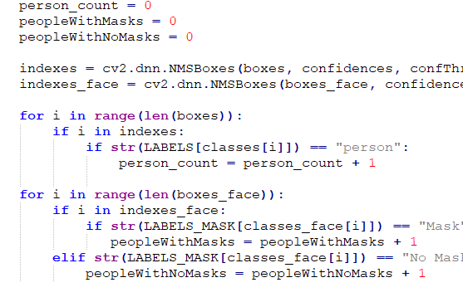
Checking Class
•For each selected bounding box, we examine its associated class.
•If the class label for that box is 'person,' we increment the person_count variable.
•If the class label is 'Mask,' we increment the peopleWithMasks variable.
•If the class label is 'No Mask,' we increment the peopleWithNoMasks variable.

Slide 25
Non-Maximum Suppression (NMS)
•We use NMS on both general object detection (boxes, confidences) and face mask detection (boxes_face, confidences_face) results.
•Similar to the object detection process, Non-Maximum Suppression (NMS) is performed to eliminate redundant or overlapping detections. This step ensures that each detected face mask instance is represented by a single bounding box.
•After filtering out redundant detections, the code proceeds to count the number of people with masks and those without masks. This is achieved by iterating through the remaining detections and analyzing their associated class labels.

Slide 26
Counting People with Masks and Without Masks
•Moving on to counting individuals with masks and without masks.
•We repeat a similar process for the face mask detection results.
• After processing all the bounding boxes, we have our final counts.
• We know how many people are in the frame (person_count), how many are wearing masks (peopleWithMasks), and how many are without masks (peopleWithNoMasks).

Slide 27
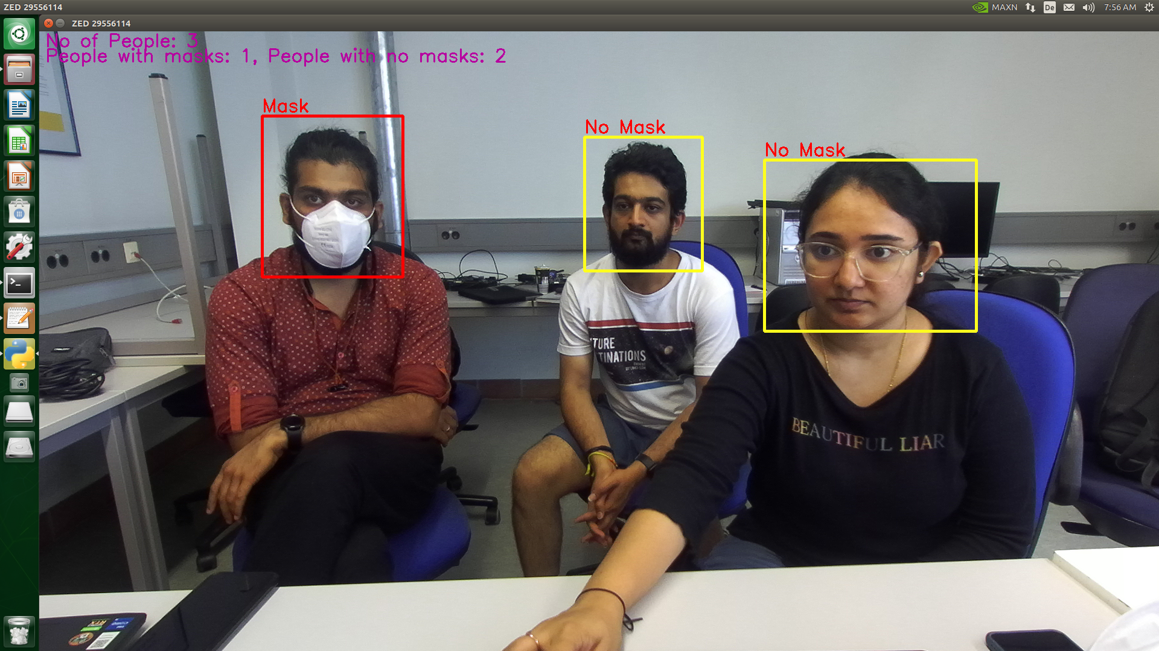
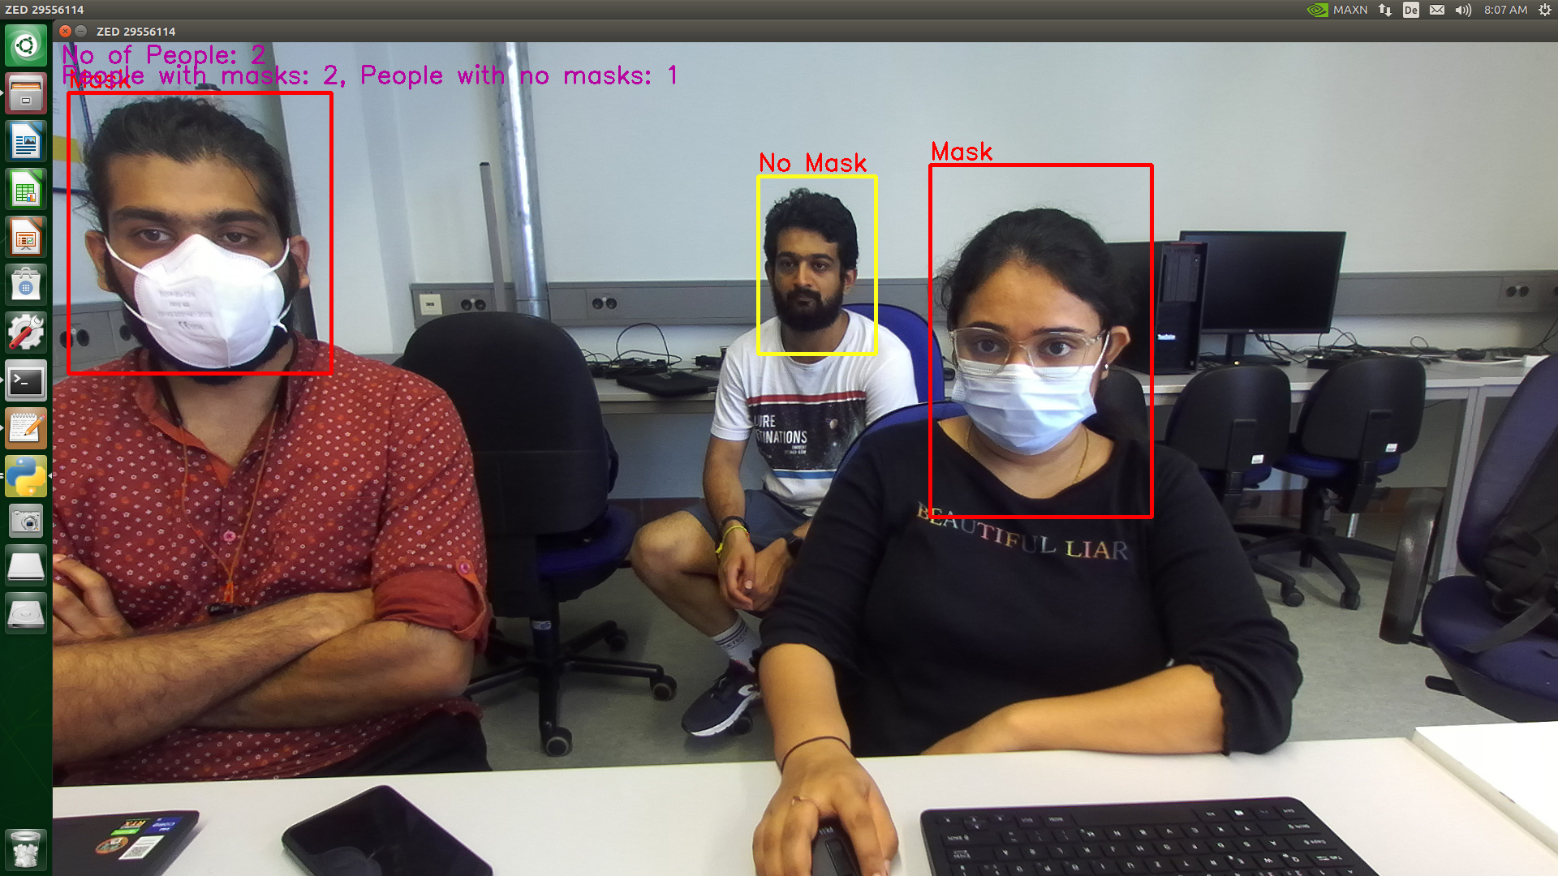

Slide 28
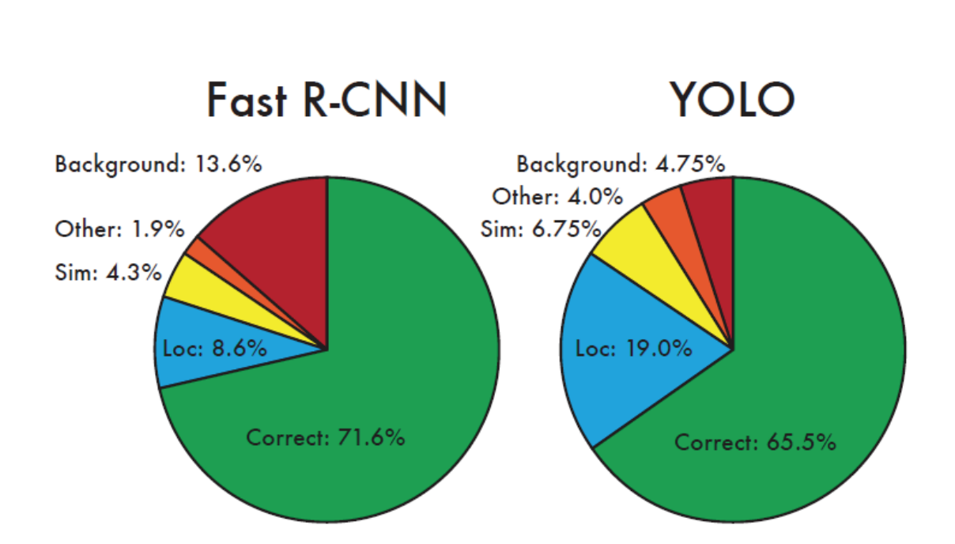
Performance Comparision
Rapid evolution in computer vision's object detection techniques.
Fusion of object classification and localization creates complexity.
Comparison: Faster R-CNN vs. YOLO:
Representative algorithms leveraging Convolutional Neural Networks (CNNs).
Performance matrix consistent, yet frameworks vary.

Slide 29
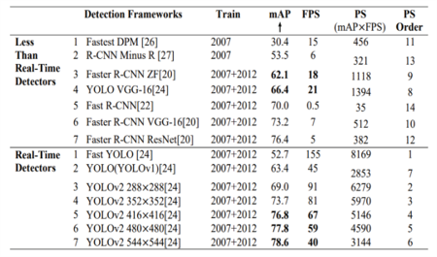
R-CNN retains image, divides regions; YOLO segments images before CNN.
YOLO uses sliding window approach, unlike local candidate regions.
Faster R-CNN with 9 anchor boxes; YOLO v2 with 5 anchor boxes; YOLO v1 no anchor boxes.
YOLO v2 introduces multidimensional clustering for precision, absent in Faster R-CNN.

Slide 30
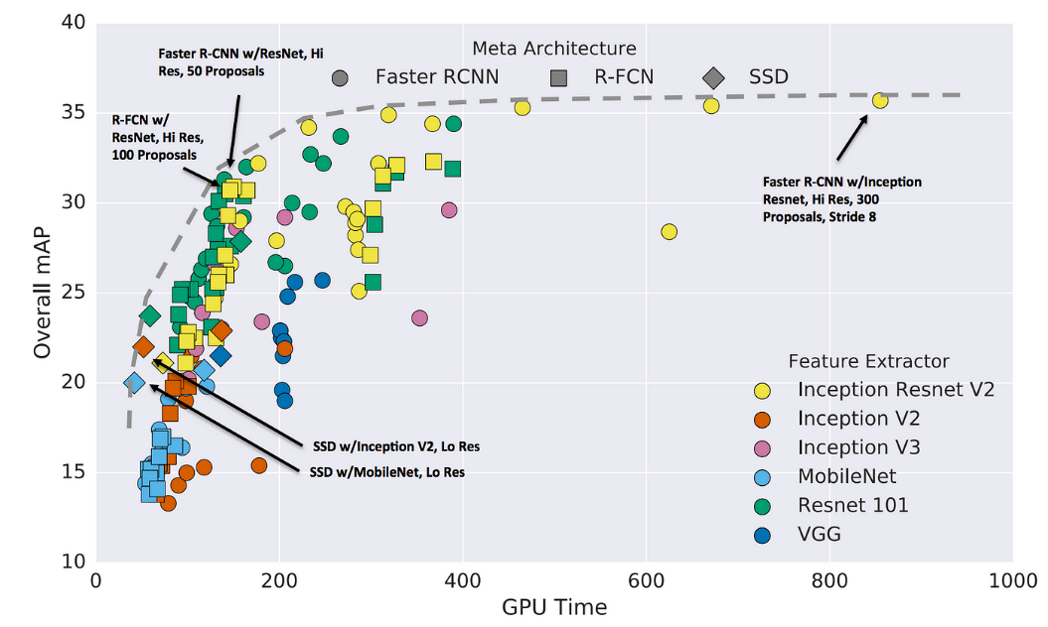
Conclusion:
Performance comparison highlights strengths of Faster R-CNN and YOLO.
Both algorithms leverage CNNs, enhancing accuracy and real-time processing.
YOLO's simplicity and direct responsiveness set it apart.
Fast and robust detection positions YOLO as an effective solution.

Slide 31
Future Scope – Sensor Fusion
In current project, we are doing object detection and distance estimation using one camera, and face mask detection using another camera. Both with yolo models.
Moving further with sensor fusion as a future implementation, we need to run object detection, distance estimation and face mask detection using one camera with yolo model. And the same with R-CNN using another camera.
Start with implementing object detection, distance estimation and face mask detection with R-CNN in one camera.
After getting the results we need to fuse them.

Slide 32
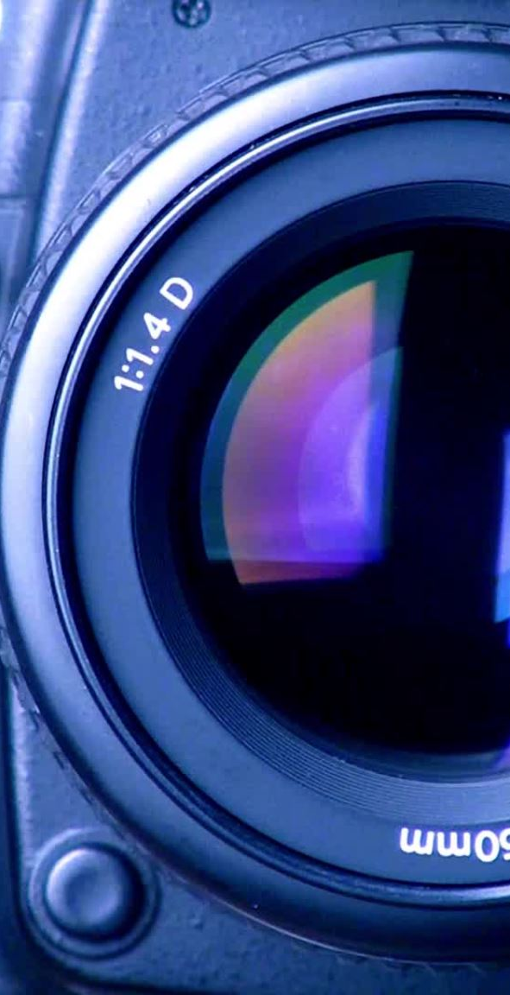
Sensor Fusion for Enhanced Object Detection
Striking a Balance: Sensor Fusion for Object Detection
"In the realm of object detection, a compelling challenge arises – achieving accurate results in real-time scenarios while maintaining a delicate equilibrium between speed and precision."
"Enter the concept of Sensor Fusion, an ingenious solution that seeks to harmonize these conflicting demands."
YOLO & R-CNN: The Speed-Precision Dilemma
YOLO – You Only Look Once:
"YOLO, or 'You Only Look Once,' offers remarkable real-time performance. It's like glancing at an image and instantly saying, 'Hey, there's a car and a dog!'"
"It divides the image into a grid, predicting bounding boxes and class probabilities within each cell. This lightning-fast approach prioritizes speed."
R-CNN – A Meticulous Approach:
"On the flip side, R-CNN follows a meticulous multi-stage process. It dives deep into the image, meticulously identifying regions of interest, extracting features, and performing classification."
"While it's accurate, this approach introduces more processing time."
The Need for Sensor Fusion
Fusing Strengths, Not Choosing Sides:
"In the world of sensor fusion, it's not a choice between YOLO and R-CNN. It's about merging their unique strengths."
"We seek to combine YOLO's speed with R-CNN's accuracy to attain both swiftness and precision."

Slide 33
Implementation Steps for sensor fusion
Data Acquisition and Preprocessing:
Set up a multi-camera system, with each camera dedicated to running YOLO and R-CNN independently.
Preprocess captured frames, ensuring they are compatible with both models.
Parallel Processing for Detection:
Run YOLO on frames from one camera and R-CNN on frames from the other.
Obtain detections from both models, which may be asynchronous due to processing speeds.
Output Synchronization and Timestamp Alignment:
Accurately timestamp the detection outputs from YOLO and R-CNN using a common reference time.
Establish a mechanism to synchronize the outputs, accounting for potential time disparities.

Slide 34
Implementation Steps for sensor fusion
Kalman Filter Integration for Fusion:
Integrate a Kalman filter into the fusion process to enhance accuracy and smooth object trajectories.
The Kalman filter operates in two key steps: prediction and correction.
Fusion and Enhanced Object Detection:
Fuse the bounding box detections from YOLO and R-CNN, including their confidence scores.
Assign weights to the detections based on the confidence scores, reflecting the reliability of each model.
Accurate Object Tracking and Future Predictions:
The Kalman-filtered detections provide more accurate trajectory estimates, reducing false positives and improving overall tracking quality
Utilize the fused detections, filtered through the Kalman filter, for robust object tracking.

Slide 35
Future Research and Development
The proposed approach serves as a foundation for further research and development:
Real-Time Synchronization Strategies: Investigate methods to ensure real-time synchronization, accounting for variations in YOLO and R-CNN processing speeds.
Dynamic Fusion Weighting: Develop algorithms to dynamically adjust fusion weights based on real-time model performance.
Hybrid Architectures: Explore the creation of hybrid models that combine YOLO and R-CNN functionalities, potentially minimizing synchronization challenges.
Multi-Model Sensor Fusion: Extend the concept to incorporate outputs from additional models or sensors for enhanced accuracy and robustness.

Slide 36
References
https://www.stereolabs.com/blog/nvidia-jetson-l4t-and-jetpack-support/
https://github.com/MINED30/Face_Mask_Detection_YOLO
https://pjreddie.com/darknet/yolo/
https://www.geeksforgeeks.org/r-cnn-vs-fast-r-cnn-vs-faster-r-cnn-ml/
https://analyticsindiamag.com/r-cnn-vs-fast-r-cnn-vs-faster-r-cnn-a-comparative-guide/
https://www.semanticscholar.org/paper/Comparison-of-CNN-and-YOLO-for-Object-Detection-Lee-Kim/22060a770c18be320e193da7a7806d83c8ea3336
https://jonathan-hui.medium.com/object-detection-speed-and-accuracy-comparison-faster-r-cnn-r-fcn-ssd-and-yolo-5425656ae359
https://www.researchgate.net/publication/339685696_A_survey_Comparison_between_Convolutional_Neural_Network_and_YOLO_in_image_identification
https://www.stereolabs.com/docs/depth-sensing/depth-settings/
http://www.utias.utoronto.ca/wp-content/uploads/2019/07/71-Fusion-Object-Detection-with-convolutional-neural-network.pdf
https://www.mathworks.com/help/vision/ug/using-kalman-filter-for-object-tracking.html

Slide 37
Thank You

